Slide 1

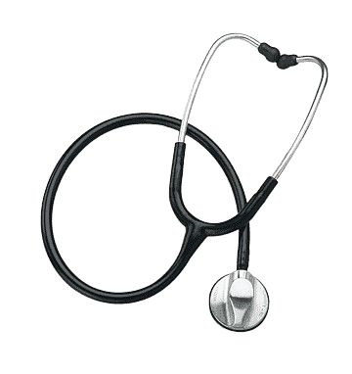

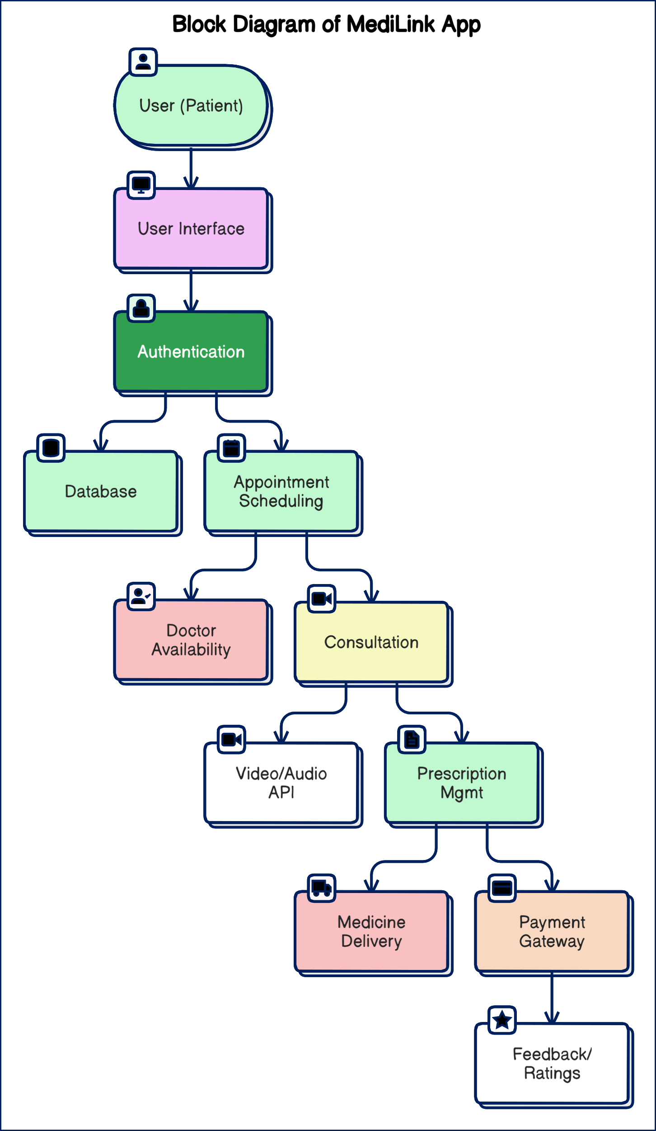
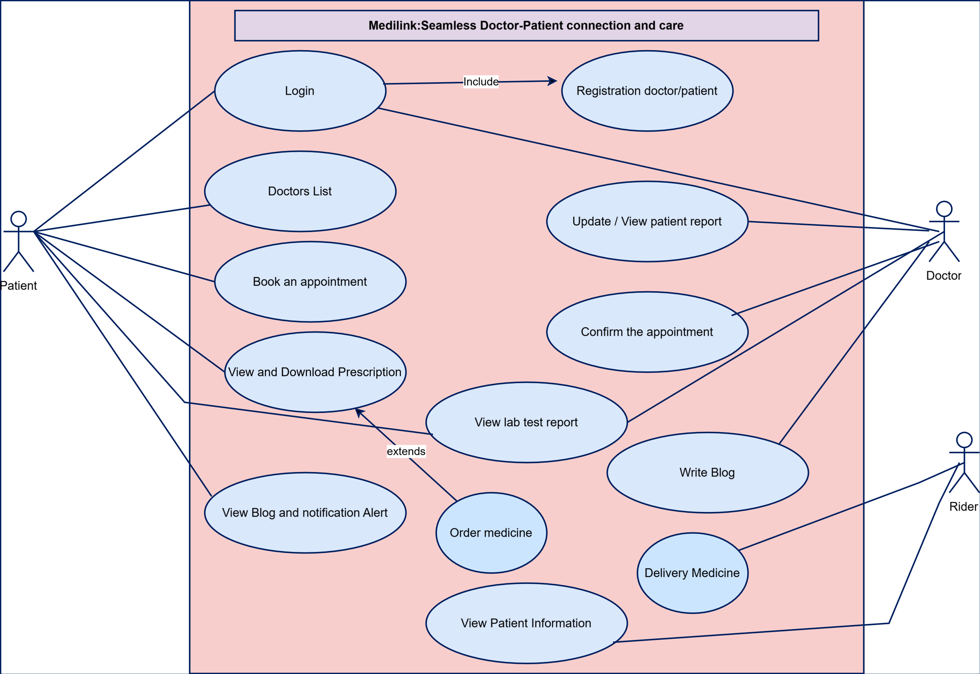
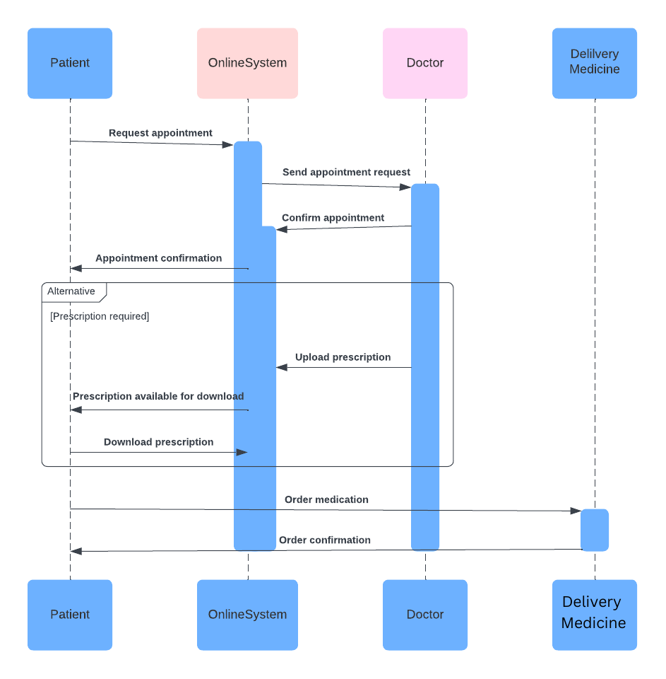
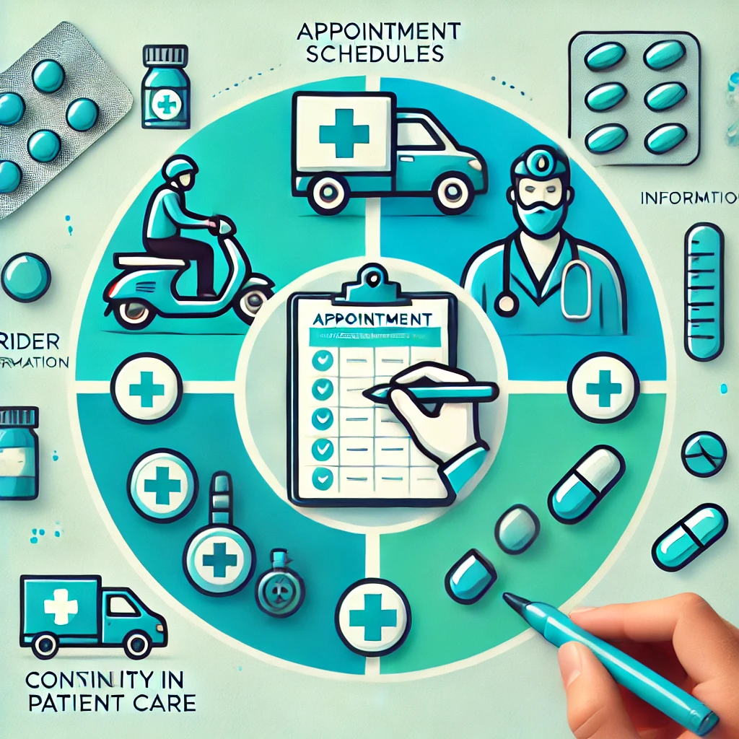
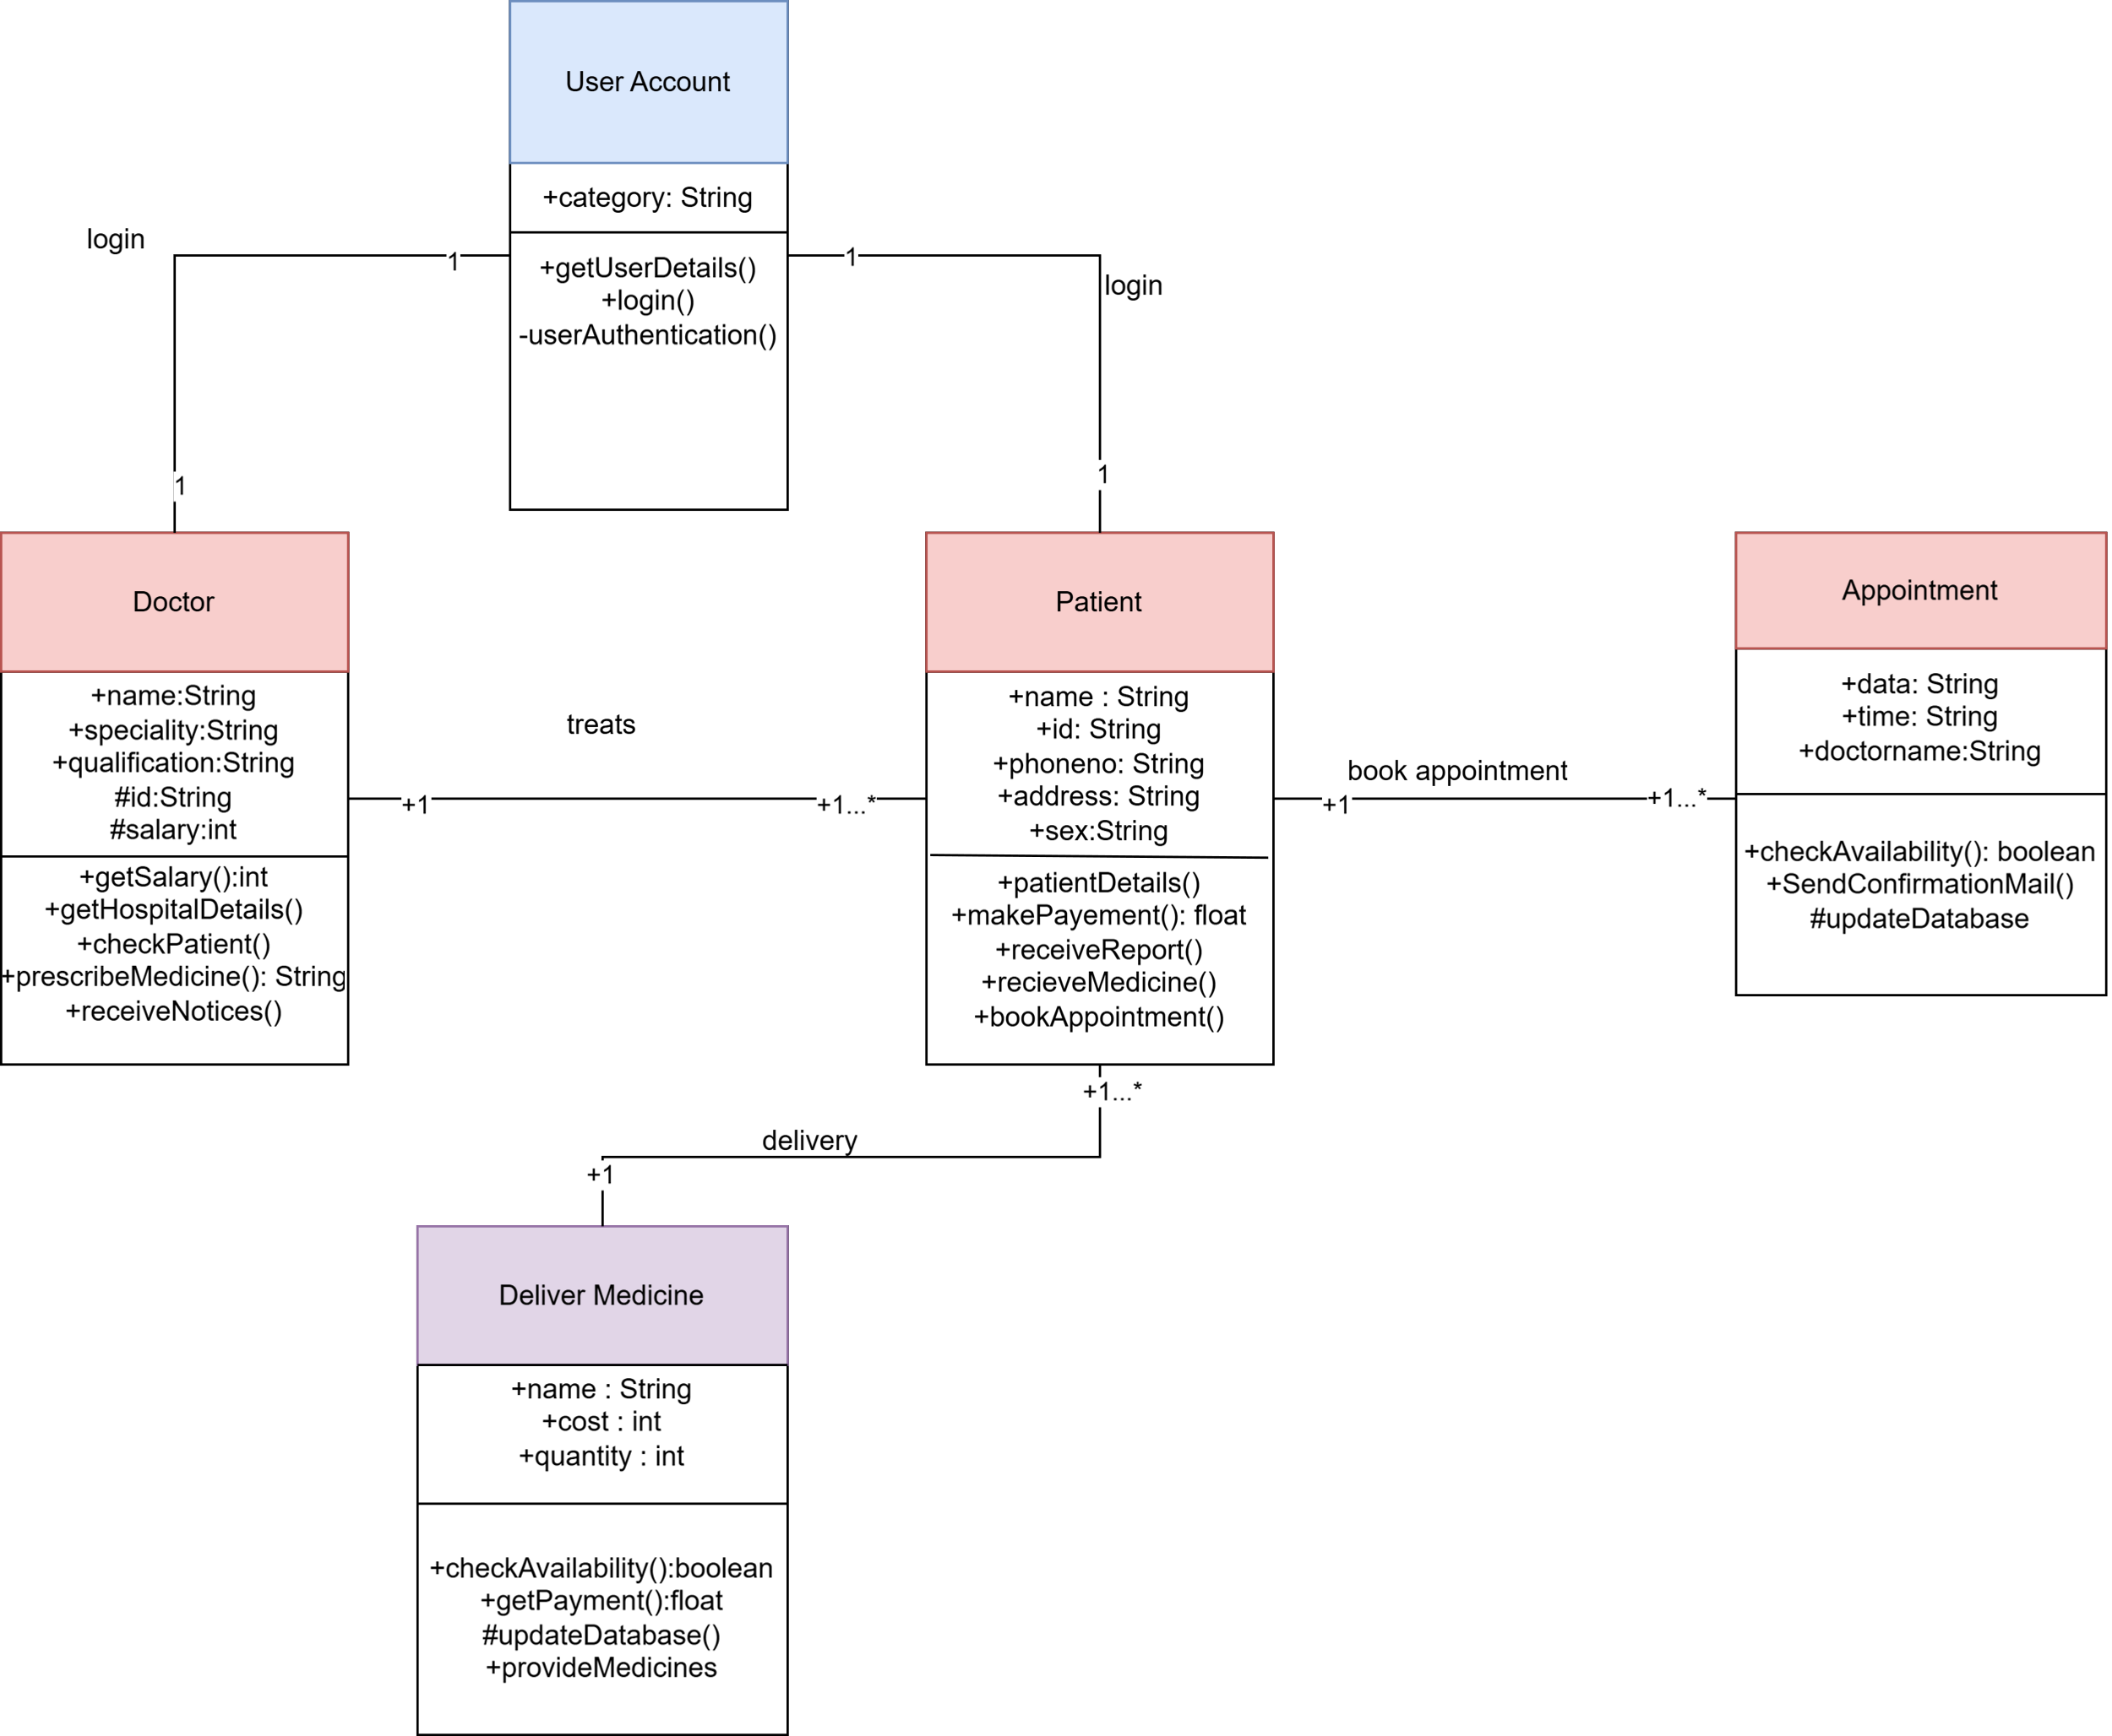

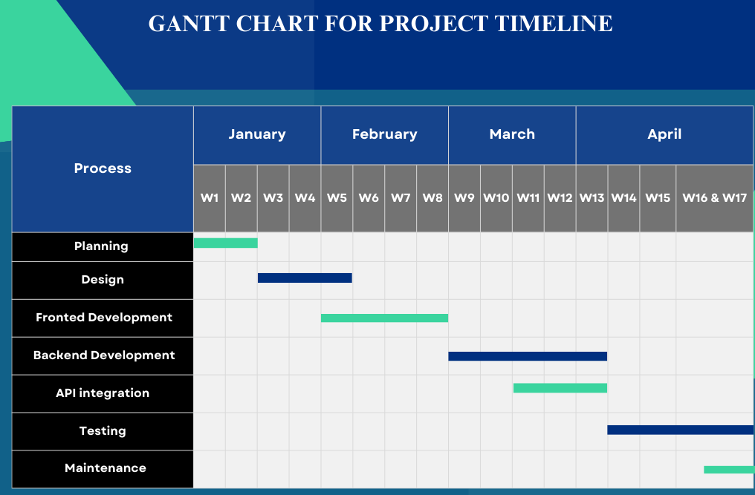


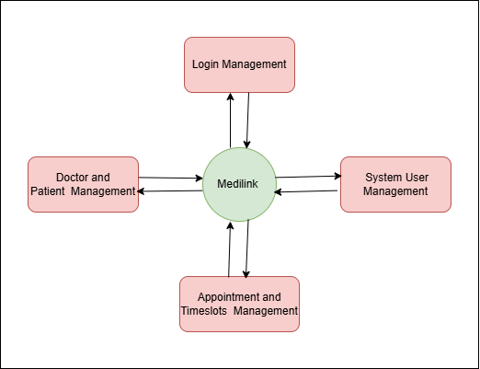
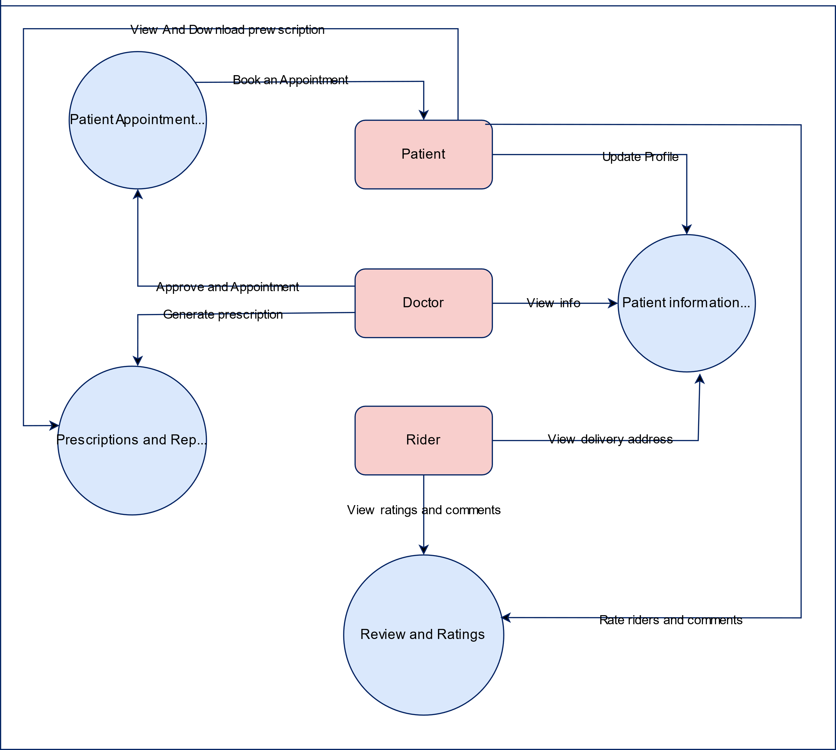
MediLink: Seamless Doctor-Patient Connection and Care
Masum Hossain*, Tamim Zia*, Sadia Islam Noor* and Tanha Tabassum Tusmi*
Department of Computer Science and Engineering, Green University of Bangladesh
1.Abstract
MediLink introduces a robust system with enhancing design to streamline task execution and user interactions in health care. By addressing existing limitations, it ensures efficiency, scalability, and seamless communication between doctor(s) and patient(s), delivering an intuitive solution to enhance service delivery and social and economical benefits.
7.Methodology
7.4.UML Use Case Diagram
2.Introduction
MediLink is designed to connect doctors and patients efficiently, offering features such as appointment scheduling, audio/video consultations, prescription management, medicine ordering, and delivery tracking. The platform aims to improve the quality of healthcare services by enabling seamless communication and remote care by saving times and money with a great social impact.
3.Problem Domain
Limited access to healthcare.
Inefficiencies in managing appointments.
Lack of continuity in patient care.
Challenges in obtaining prescribed medicines
7.5.Sequence Diagram
4.Motivation
To improve access to healthcare in remote areas.
To provide a time-efficient solution for both patients and doctors.
To streamline the process of consultations, prescriptions and medicine delivery..
To provide new employment for doctors and riders for a great economical impact.
Provides new
Employment.
Improve Healthcare for remote areas.
Consultations and Medicine Delivery
Efficient time management.
7.1.SRS
Functional Requirements
User Management: Patient/Doctor registration, secure login.
Appointment Management: Book, cancel, and reschedule appointments.
Consultation: Real-time audio/video calls and chat.
Prescription: Digital prescriptions and medicine ordering.
Payments: Online payments and cash on delivery.
Feedback: Ratings and reviews for doctors.
Notifications: Email/SMS alerts for appointments and updates.
Non-Functional Requirements
Performance: Fast load times, smooth audio/video.
Security: Encrypted data, multi-factor login.
Scalability: Supports thousands of users.
Reliability: 99.9% uptime.
Usability: User-friendly interface.
Compatibility: Works on browsers, Android, iOS.
Maintainability: Easy updates.
7.6.UML Class Diagram
5.Objective
Develop a platform for doctor-patient interaction.
Implement features like appointment booking, prescription management and medicine delivery.
Integrate a rating system for doctors and riders.
6.Literature Review
Serial No. | Software | Contribution | Limitation
1 | DocTime[6] | Online consultations and scheduling | Limited rider tracking for deliveries
2 | Doctor Dekhao | Secure video consultations[3] | Lacks detailed medicine information
3 | Zocdoc[4] | Appointment scheduling | No prescription management
4 | Practo[5] | Medicine delivery integration | Complex UI for users
Social Impact
Provides accessible healthcare to remote areas.[1]
Reduces waiting times and administrative inefficiencies.
Empowers patients to manage their health records digitally enhances trust in telemedicine.[2]
Reduces environmental impact through digital solutions.
Provides the new employment with social benefits.[3]
7.2.SDLC
Conclusion
The project bridges the gap between doctors and patients, offering seamless appointment scheduling, online consultations[2], and efficient prescription management. By integrating real-world functionalities like medicine delivery and user-friendly interfaces, it enhances accessibility and convenience, ensuring better healthcare experiences for patients while optimizing
doctors' time and resources effectively.
Functionalities | DocTime | Doctor Dekhao | Zocdoc | Practo
Secure Video Consultations
Appointment Scheduling
Medicine Info and Blogs
Delivery and Rider Tracking
7.3.DFD
References
[1]B. Smith, "Online Doctor Appointment Systems: A Study on Efficiency and Scalability," Journal of Health Informatics, vol. 12, no. 3, pp. 45-50, 2023.
[2]P. Johnson, "Telemedicine Platforms: An Emerging Healthcare Solution," IEEE Transactions on Health Systems, vol. 9, no. 4, pp. 120-130, 2022.
[3]K. Patel, "Secure and Reliable Video Consultation Systems for Patients," International Journal of Telehealth, vol. 8, pp. 15-25, 2021.
[4]"Zocdoc: Online Doctor Appointment Scheduling," https://www.zocdoc.com.
[5]"Practo: Healthcare Services Platform," https://www.practo.com.
[6] “DocTime: A Bangladeshi Telemedicine App, https://doctime.com.bd””
[7]"Telemedicine and Telehealth: Future of Digital Healthcare," World Health Organization (WHO), 2023 Report.
.
Showing the contributions and limitations as a tabular format.
DFD for Level 0.
DFD for Level 1.
This poster presentation is made for Green University of Bangladesh by Department of Computer Science and Engineering.
Purbachal American City, Kanchon 1460.
Copyright © 2003-2024 Green University of Bangladesh || All rights reserved.

